Slide 1
FTEC 5530 Evaluating the Effectiveness of Machine Learning in Cryptocurrency Trading
Group 6 Members:
CHEN Angyu 1155197620 JIANG Tianyun 1155197611
CHEN Yunfan 1155198241 LIANG Haojin 1155200065
HUANG Shiqi 1155204275 NIU Xinyan 1155201239

Slide 2
Table of contents
01
Introduction
05
Strategy & Backtesting
02
Data Processing
06
Results
03
Model Comparison
07
Summary
04
Model Training

Slide 3
01
Introduction
CHEN Yunfan

Slide 4
Group 6 | Evaluating the Effectiveness of Machine Learning in Cryptocurrency Trading | CHEN Yunfan
Motivation
Challenges with Traditional Models:
Inability to capture temporal dependencies.
Difficulty handling non-linear relationships.
Limited adaptability to market changes.
Inadequate management of high-dimensional data.
Advantages of ML Techniques:
Superiority in capturing temporal dependencies with LSTM models.
Effective modeling of non-linear market dynamics.
Enhanced adaptability to evolving market conditions.
Efficient processing of high-dimensional data.
VS
Introduction | Data Processing | Model Comparison | Model Training | Strategy & Backtesting | Results | Summary
Notes:
传统模型，如统计模型和线性回归，在应对动态复杂的加密货币市场时存在局限。它们难以捕捉价格的时间依赖性，处理非线性关系，适应市场变化，以及有效管理高维数据。
这些挑战激发了我们利用ML技术，特别是长短期记忆（LSTM）模型，来克服传统模型的不足。LSTM模型在捕捉时间序列模式、适应市场动态、以及处理复杂数据方面展现出巨大潜力。
我们的目标是开发一种交易策略，不仅能够超越传统模型，还能提供更稳定和准确的预测。通过评估LSTM在加密货币交易中的效果，我们希望证明ML技术的优势，并展示其在生成更可靠交易策略方面的潜力。

Slide 5
Group 6 | Evaluating the Effectiveness of Machine Learning in Cryptocurrency Trading | CHEN Yunfan
Literature Review
Features and Datasets for Cryptocurrency Prediction
Title | Model
Historical data | Open, high, low, and close prices along with volume are important factors for cryptocurrency prediction.
Intraday Price Prediction | A study suggests that using five lagged prices as inputs can effectively predict the next 5-minute price of Bitcoin. Including additional inputs may not be advantageous.
Additional Factors | Cryptocurrency data such as block size, hash rate, mempool transaction count, mempool size, Google Trend Search Volume Index, and gold spot price have been combined with historical data for price prediction.
Macroeconomic Indicators | Crude oil futures prices, gold futures prices, S&P500 futures, NASDAQ futures, and DAX index historical price data have been used along with Bitcoin historical prices to predict the direction, maximum, and minimum closing prices.
Technical Indicators | Crude oil futures prices, gold futures prices, S&P500 futures, NASDAQ futures, and DAX index historical price data have been used along with Bitcoin historical prices to predict the direction, maximum, and minimum closing prices.
Introduction | Data Processing | Model Comparison | Model Training | Strategy & Backtesting | Results | Summary

Slide 6
Group 6 | Evaluating the Effectiveness of Machine Learning in Cryptocurrency Trading | CHEN Yunfan
Literature Review
Models for Cryptocurrency Prediction
Cryptocurrency | Recommended Models | Accuracy/Performance
Bitcoin | Linear regression | Outperform machine learning models for daily prices
 | Machine learning models | Outperform statistical models for 5-min predictions
 | SVM w/ radial basis kernel | Provides significantly better results
 | LSTM | Highly recommendable for real-time price prediction
Ethereum | SVM w/ feature extraction | 99%
 | LSTM | 67.20% for price prediction
 | LSTM w/ technical indicators | 99% for daily direction prediction
 | LSTM w/ technical indicators + social network info | 87% (with trading indicators)
Introduction | Data Processing | Model Comparison | Model Training | Strategy & Backtesting | Results | Summary

Slide 7
02
Data Processing
JIANG Tianyun

Slide 8
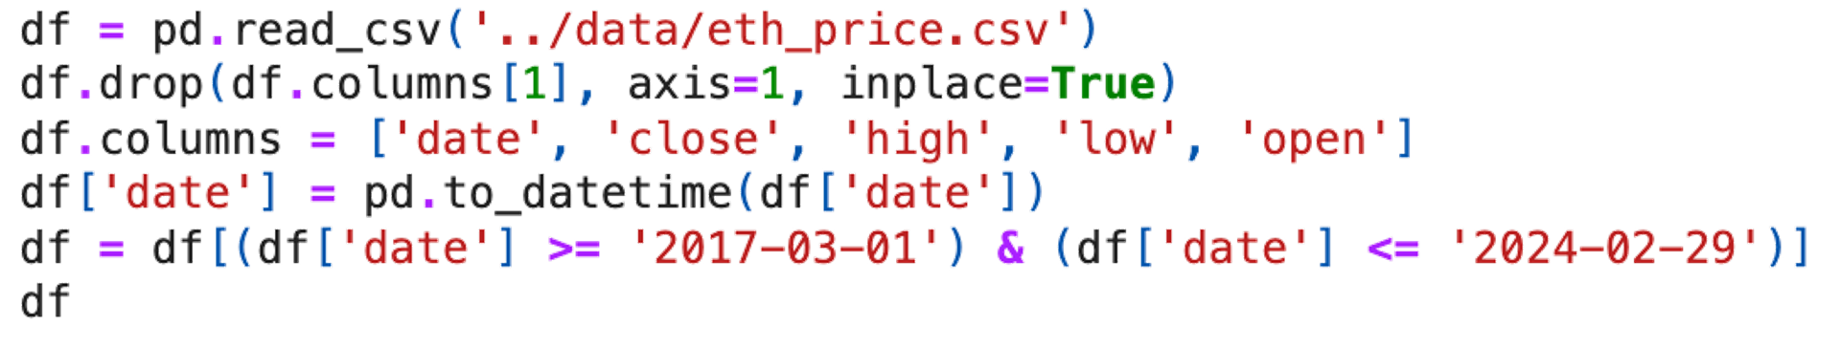
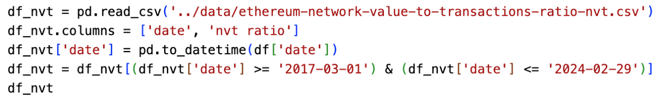
Integrating Historical Prices and NVT Ratio
Group 6 | Evaluating the Effectiveness of Machine Learning in Cryptocurrency Trading | JIANG Tianyun
Data Source: Glassnode Studio - A trusted provider of comprehensive Ethereum data.
Data Sets:
Training Set: March 1, 2017, to July 3, 2019
Testing & Backtesting Set: July 3, 2019, to February 29, 2024
Historical Ethereum Pricing Data:
Details: Daily Open, High, Low, Close (OHLC) prices in USD.
Importance: Foundation for predictive modeling and market performance insights.
Ethereum NVT Ratio:
Definition: Network Value to Transactions Ratio.
Function: Evaluates Ethereum's valuation against transaction value, akin to the PE Ratio in equities.
Introduction | Data Processing | Model Comparison | Model Training | Strategy & Backtesting | Results | Summary
Notes:
Our analytical journey begins with the data processing. We've secured our dataset from Glassnode Studio, which provides Ethereum's historical prices and NVT Ratio. This data, ranging from March 1, 2017, to July 3, 2019, for training, and then extending to February 29, 2024, for testing and backtesting, is prepared to ensure accuracy and relevance."
"The historical pricing data, including daily Open, High, Low, Close in USD, it's offering invaluable insights into the market's performance and volatility."
It's complemented by the Ethereum NVT Ratio, a valuation metric similar to the PE Ratio, The right slide shows the code for data processing

Slide 9
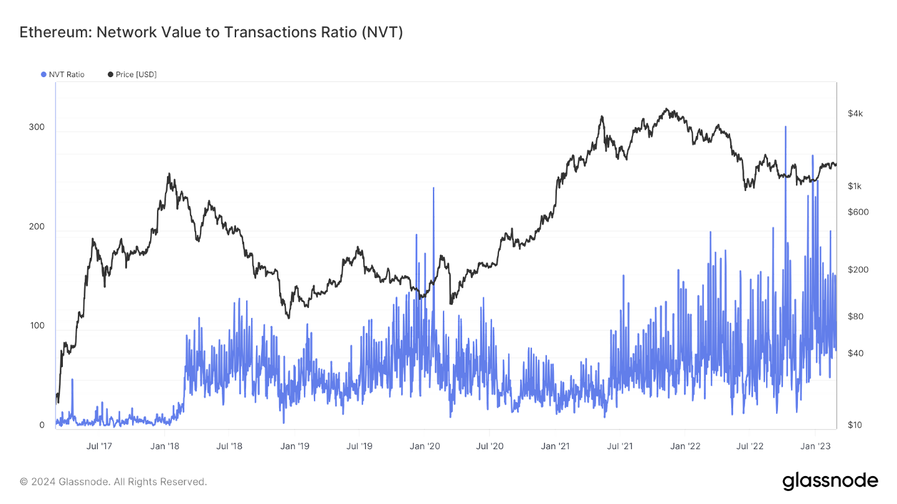
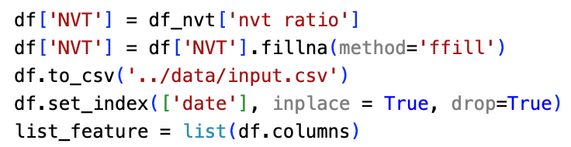
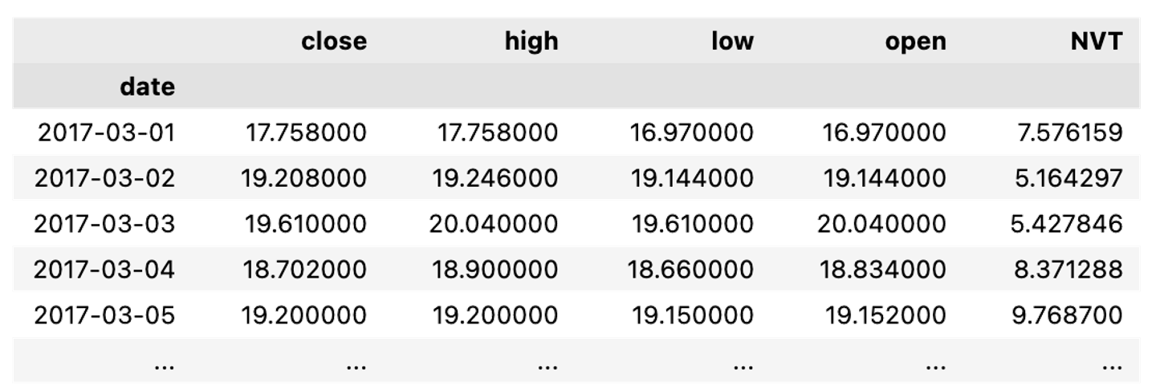
Group 6 | Evaluating the Effectiveness of Machine Learning in Cryptocurrency Trading | JIANG Tianyun
Introduction to NVT:
Market Indication: Assesses potential market overvaluation or undervaluation.
Role of NVT Ratio:
High NVT: Suggests possible speculative bubble；Low NVT: Indicates potential undervalued network status.
Data Merging Strategy:
Objective: To create a unified dataset reflecting Ethereum's market dynamics.
Approach: Combines price data with NVT Ratio for a holistic analytical perspective.
Introduction | Data Processing | Model Comparison | Model Training | Strategy & Backtesting | Results | Summary
Notes:
The reason to choose NVT is that helps us detect market bubbles or undervalued conditions. A high NVT Ratio signals potential overvaluation
To capitalize on these insights, we've merged price data with the NVT Ratio, creating a robust dataset for our LSTM models to capture the complex interplay between price movements and network valuation

Slide 10
03
Model Comparison
CHEN Angyu

Slide 11
Comparism
Group 6 | Evaluating the Effectiveness of Machine Learning in Cryptocurrency Trading | CHEN Angyu
Linear Regression Model
A statistical approach for modeling the relationship between a dependent variable and one or more independent variables by fitting a linear equation to observed data.
Pros: Simple, easy to understand and implement
Cons: May not capture non-linear characteristics and long-term dependencies of the data
Long Short-Term Memory Model
A type of Recurrent Neural Network (RNN), well-suited for time series prediction due to its ability to maintain a memory of past information and integrate it with new data inputs.
Pros: Able to learn long-term dependencies for complex time series data.
Cons: Complex, requiring more computational resources and data, longer training time
Introduction | Data Processing | Model Comparison | Model Training | Strategy & Backtesting | Results | Summary
Notes:
My name is CHEN Angyu.
In this section, we mainly consider two models. Long Short-Term Memory Model is a type of Recurrent Neural Network (RNN), well-suited for time series prediction due to its ability to maintain a memory of past information and integrate it with new data inputs.
Compared with it, linear regression model is more simple, easy to implement. But it is unable to capture non-linear characteristics and long-term dependencies of the data.
In the results section, we will explain the performance of the two models, and now I will talk about the comparison of the algorithms.

Slide 12
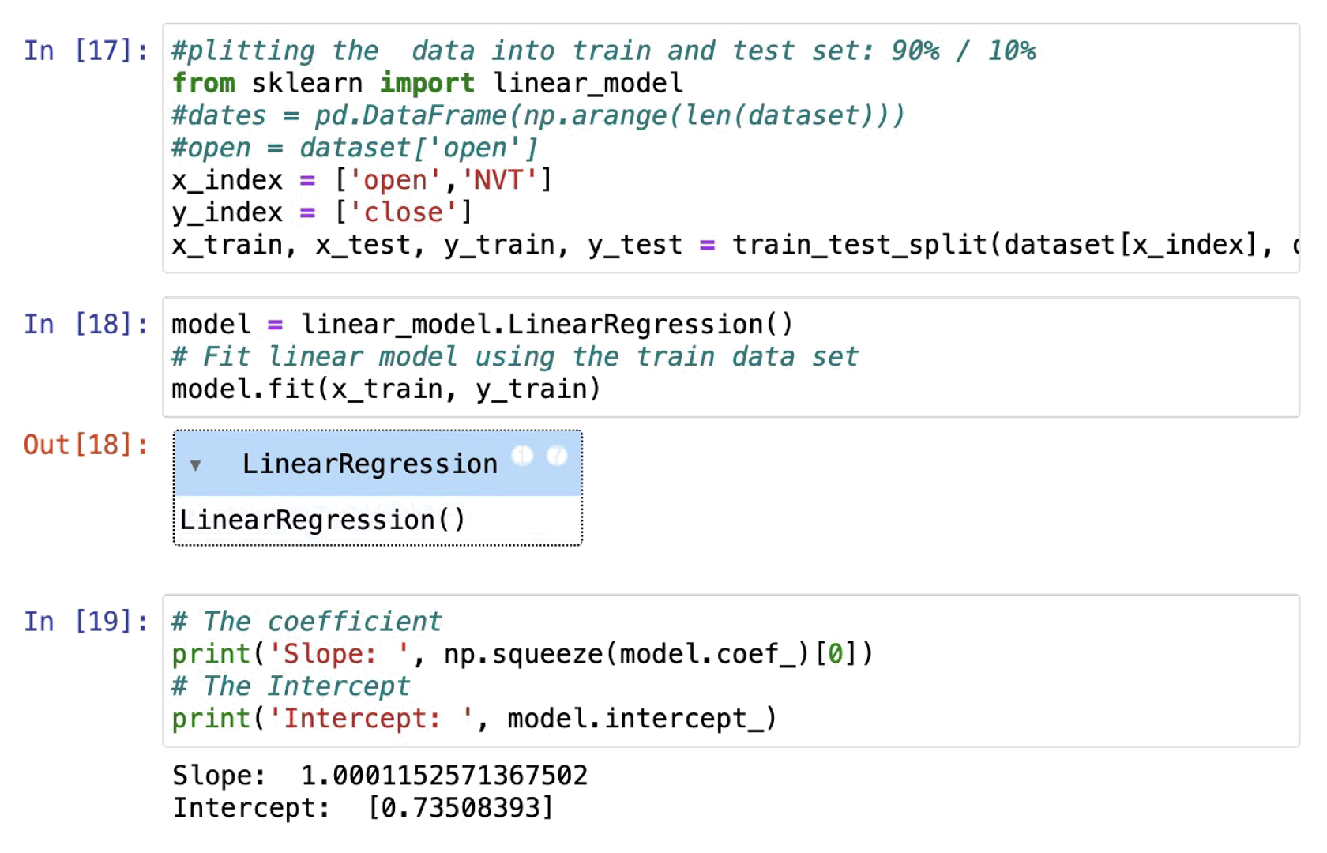
Linear Regression Model
Group 6 | Evaluating the Effectiveness of Machine Learning in Cryptocurrency Trading | CHEN Angyu
Identify variables: High price, low price, open price, and NVT.
Multicollinearity test:
A significant multicollinearity issue among the high price, low price, and open price.
Model construction:
Use open price and NVT;
Fit the model on the training dataset;
Estimate the parameters (slope and intercept) to minimize the error between predictions and the actual values.
Prediction: Output the results of the test set.
Model Evaluation: Calculate MSE, RMSE, R2 and Explained Variance.
Introduction | Data Processing | Model Comparison | Model Training | Strategy & Backtesting | Results | Summary
Notes:
Firstly, we identify variables. But after a multicollinearity test, the model was built using open price and NVT, and the linear regression model was fitted using the fit method on the training dataset. It will estimate the parameters of the linear equation to minimize the error between the model's predictions and the actual values for the training dataset.

Slide 13
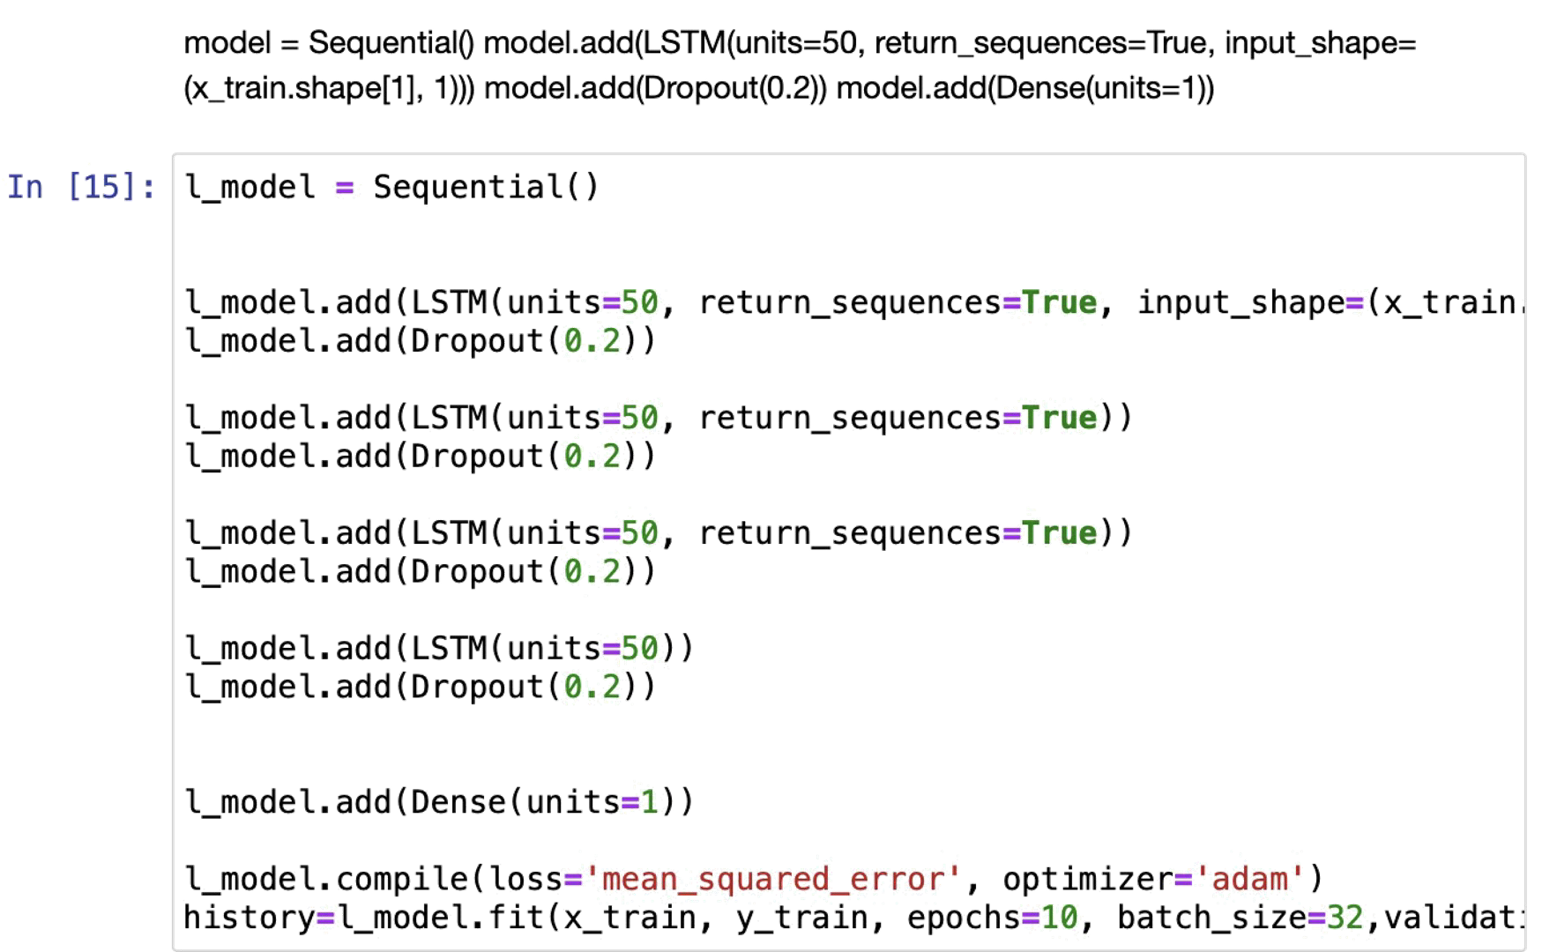
Long Short-Term Memory Model
Group 6 | Evaluating the Effectiveness of Machine Learning in Cryptocurrency Trading | CHEN Angyu
Data processing:
Divide the data into training and testing sets;
Create MinMaxScaler instances to scale the features to the range of [0,1].
Model construction:
Create a serialized original time series data;
Add the first LSTM layer to receive input data;
Add a dropout layer to randomly discard 20% of neurons to reduce overfitting;
Repeat the above two steps
Prediction: Add dense layer, the output layer of the network model.
Model Evaluation: Calculate MSE, RMSE, R2 and Explained Variance.
Introduction | Data Processing | Model Comparison | Model Training | Strategy & Backtesting | Results | Summary
Notes:
After dividing the data into training and testing sets, create MinMaxScaler to scale the features to the range of [0,1]. Create a serialized dataset from the original time series and the corresponding output is the value of the next time point. Add the first LSTM layer to receive input data, add a Dropout layer to randomly discard 20% of neurons to reduce overfitting, repeat the two steps. Finally, The Dense layer serves as the output layer of the network and compiles the model.
Now let’s welcome Xinyan to introduce model training.

Slide 14
04
Model Training
NIU Xinyan

Slide 15
Multi-Factor LSTM Prediction Model
Group 6 | Evaluating the Effectiveness of Machine Learning in Cryptocurrency Trading | NIU Xinyan
Feature Normalization
Train_Test Split
LSTM
P
1
4
Train_X, Train_Y
Test_X, Test_Y
MinMaxScaler
Supervised Learning Transformation
Build and Train the Model
2
5
E
L
series_to_supervised()
Loss: MAE
Dense
Input and Output Matrix Split
3
6
Model Evaluation
S
E
Input: X
Output: Y
Yhat
Introduction | Data Processing | Model Comparison | Model Training | Strategy & Backtesting | Results | Summary
Notes:
I’m NIU Xinyan
In this part I will show how to build an LSTM model to predict the price of ethereum, with a total of six steps as follows

Slide 16
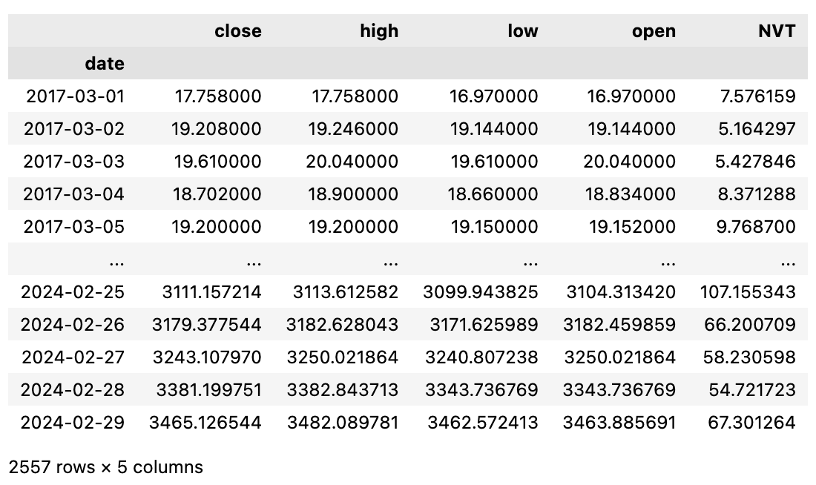
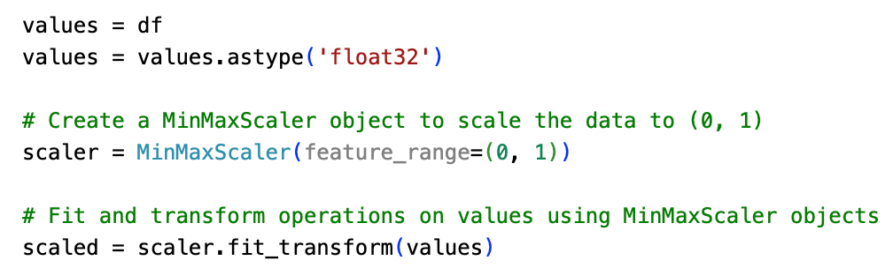
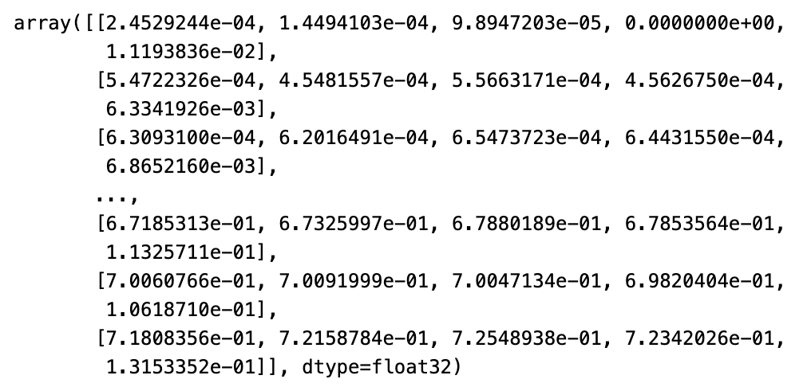
Step 1: Feature Normalization
Group 6 | Evaluating the Effectiveness of Machine Learning in Cryptocurrency Trading | NIU Xinyan
1
2
3
Data Fitting
Calculate Max
and Min
Data Scaling
Introduction | Data Processing | Model Comparison | Model Training | Strategy & Backtesting | Results | Summary
Notes:
In the first step, the data is normalised by scaling all features to between 0 and 1 to ensure that each feature has the same weight during model training

Slide 17
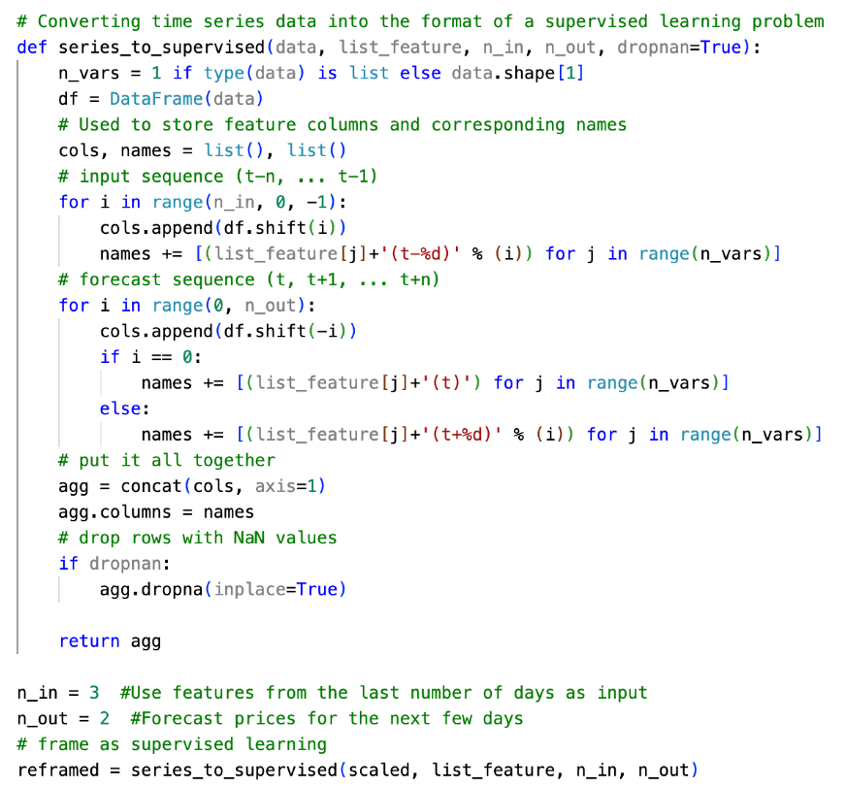
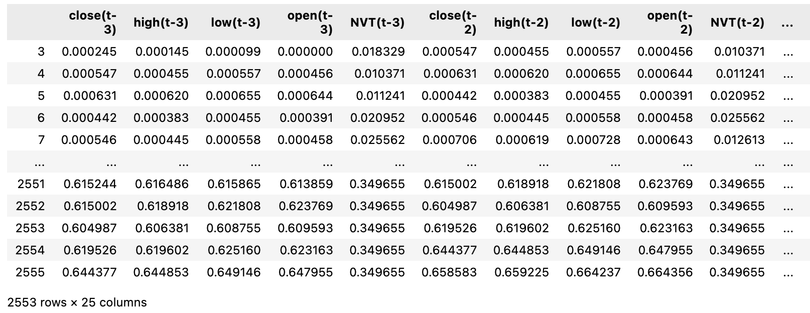
Step 2: Supervised Learning Transformation
Group 6 | Evaluating the Effectiveness of Machine Learning in Cryptocurrency Trading | NIU Xinyan
Time Series -> Supervised Learning
To train models that predict future outcomes based on historical data
Generates lagged features to represent past observations
Generate targets to represent future price movements
Rows containing missing values are removed
Introduction | Data Processing | Model Comparison | Model Training | Strategy & Backtesting | Results | Summary
Notes:
The second step is to convert the time series data into supervised learning problem
in order to train a model that predicts future outcomes based on historical data.
The function "series_to_supervised" is used to reorganise the dataset and create input features and output targets.
Finally, delete rows containing missing values to improve the robustness of the model.

Slide 18
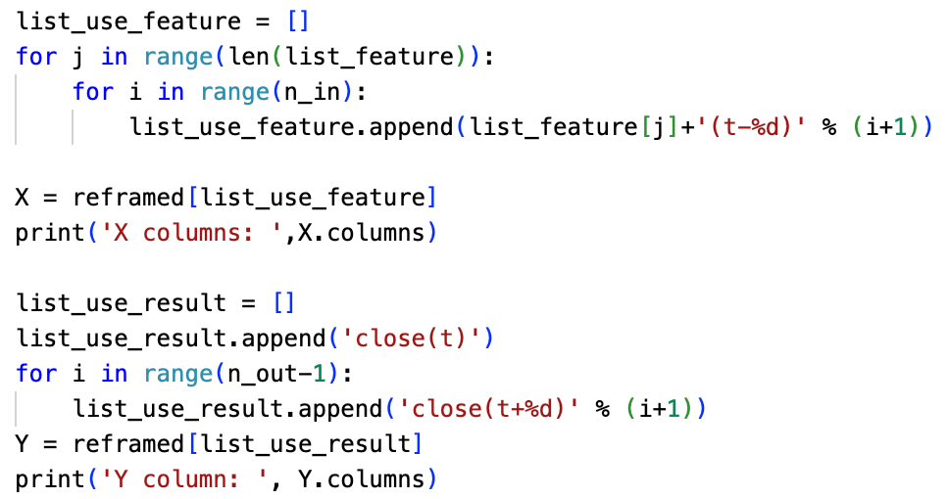
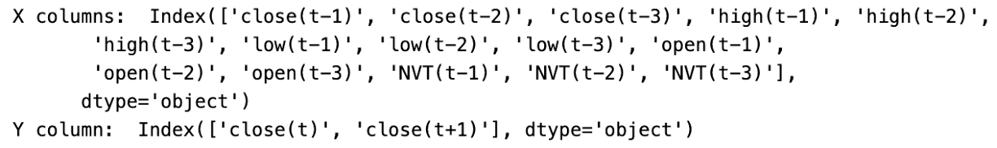
Step 3: Input and Output Matrix Split
Group 6 | Evaluating the Effectiveness of Machine Learning in Cryptocurrency Trading | NIU Xinyan
Input
X
Historical characteristics from close(t-n_in) to close(t-1) for predicting future price movements
Output
Y
The target value that the model will try to predict, focusing on the close(t) to close(t+(n_out-1))
Introduction | Data Processing | Model Comparison | Model Training | Strategy & Backtesting | Results | Summary
Notes:
The third step is to transform the reconstructed dataset into an input set (X) and an output set (Y).
The input set consists of historical features from t-3 to t-1.
The output set contains the target values that the model will try to predict
The following figure lists respectively the names of the features for the input and output sets

Slide 19
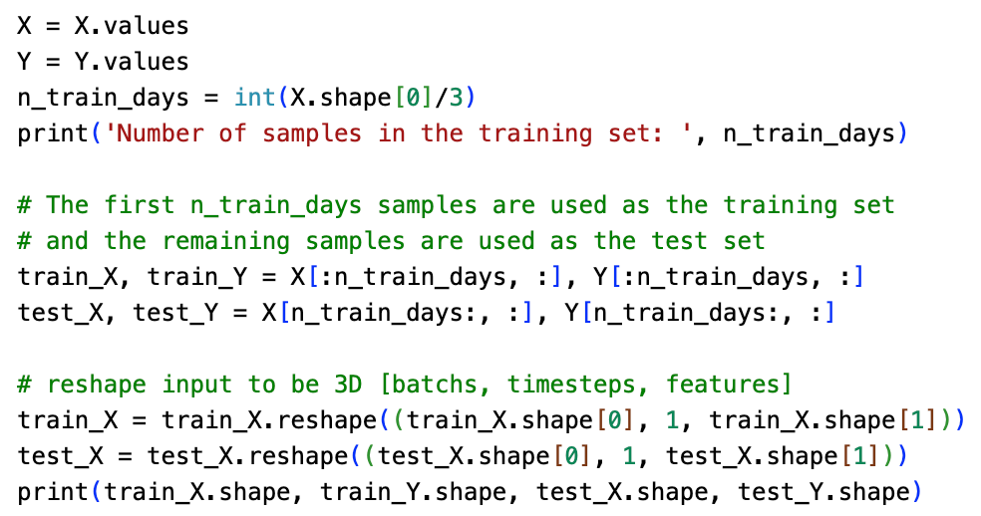
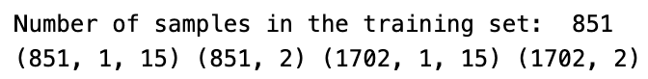
Step 4: Train-Test Split
Group 6 | Evaluating the Effectiveness of Machine Learning in Cryptocurrency Trading | NIU Xinyan
Reshape to 3D
The data is divided into a training set and a test set, the first "n_train_days" samples are assigned to the training set and the rest of the samples form the test set
Reshape the input features into a 3D tensor format suitable for neural network input, including dimensions such as batch size, time step and number of features
Introduction | Data Processing | Model Comparison | Model Training | Strategy & Backtesting | Results | Summary
Notes:
The fourth step is to split the training and test sets. We assign the first one third of the samples to the training set and others to the test set, this split is to allow the model to validate its predictions on unknown data, which is crucial for assessing the model's generalisation ability.
For the input set, we reshape the input features into a 3D tensor format suitable for neural network inputs, including the dimensions of batch size, time step, and number of features.
At the same time, setting the time step to 1 ensures that each input sequence is processed independently at each point in time, regardless of the time relationship between them

Slide 20
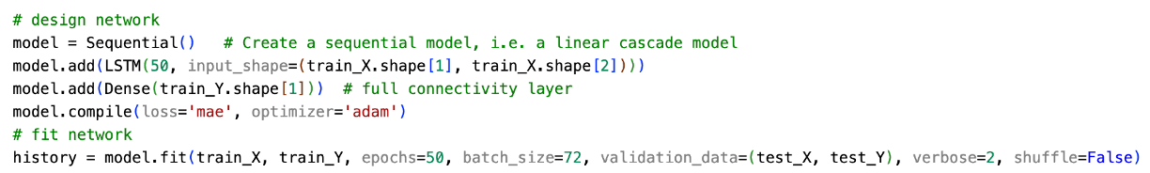
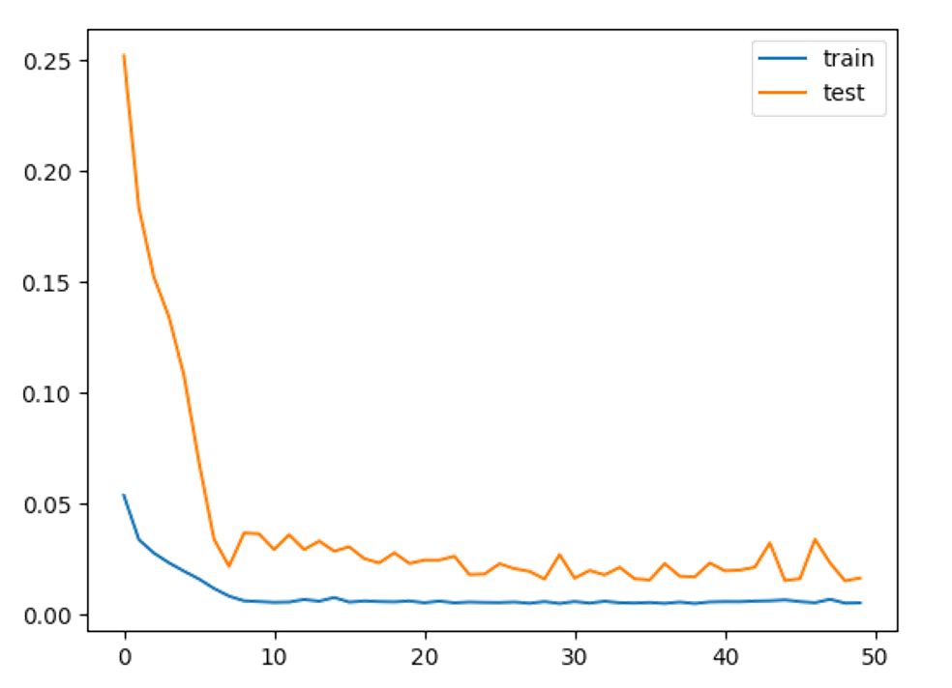
Step 5: Building and Training the LSTM Model
Group 6 | Evaluating the Effectiveness of Machine Learning in Cryptocurrency Trading | NIU Xinyan
LSTM Layer
Processing of sequence data
Dense Layer
Temporal patterns are transformed into final predictions
Loss
Mean Absolute Error (MAE)
Optimization
Adam
Fitting
Epoch: 50, Batch Size: 72, Verbose: 2
Introduction | Data Processing | Model Comparison | Model Training | Strategy & Backtesting | Results | Summary
Notes:
The fifth step is to construct an LSTM model based on the Keras framework.
First, create a sequence model. The first layer is an LSTM layer to process the sequence data and capture the time dependencies.
Then we introduce a fully-connected Dense layer to transform the temporal patterns learnt from the LSTM layer into the final prediction results.
And we chose the MAE as the loss function, cause it’s well suited to handle regression problem.
And we employed the Adam optimiser to certain its efficiency.
In our training process, we used the"fit" function, attention to avoid shuffling the data to maintain the temporal order of the time series data.
Finally, we plot the loss values of the training and test sets on a graph. We can see that the loss values have a tendency to decrease sharply with the number of epochs on both the training and test sets

Slide 21
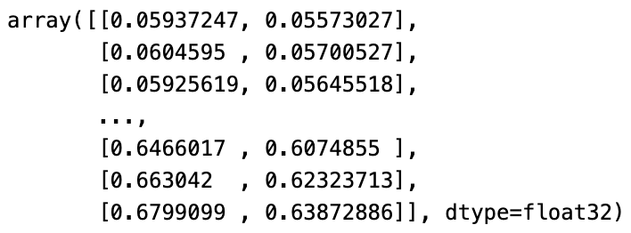
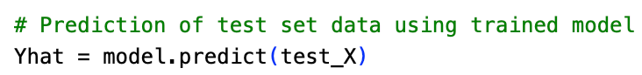
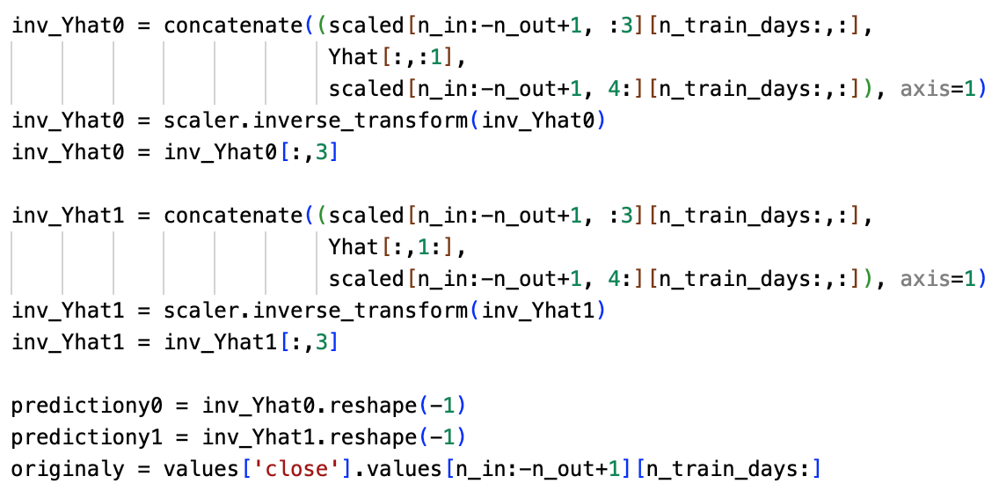
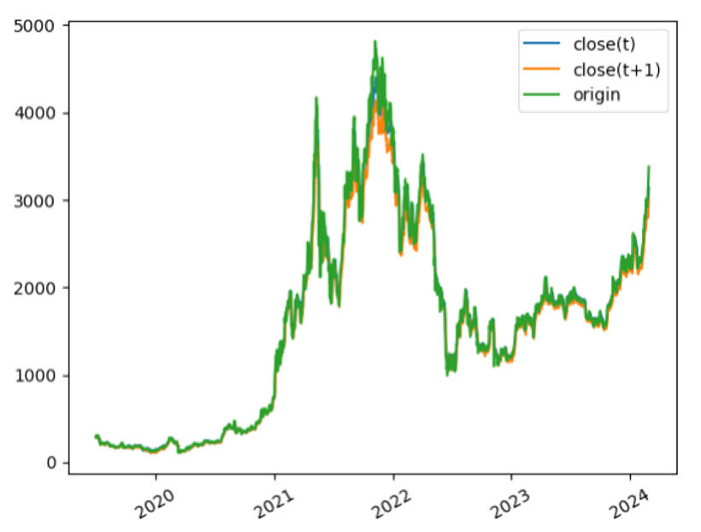
Step 6: Model Evaluation
Group 6 | Evaluating the Effectiveness of Machine Learning in Cryptocurrency Trading | NIU Xinyan
Predicted close(t) & close(t+1)
predicted closing price & actual Ether price
Introduction | Data Processing | Model Comparison | Model Training | Strategy & Backtesting | Results | Summary
Notes:
The final step is model evaluation.
As we can see in the graph on the right, after scaled back to the original data, our model is able to closely track the trend of the actual price, which shows it’s effective in capturing the ETH price movements, and also shows the effectiveness of our model
So let’s turn to Haojin

Slide 22
05
Strategy & Back-testing
LIANG Haojin
Notes:
Let’s move to trading strategy and back testing

Slide 23
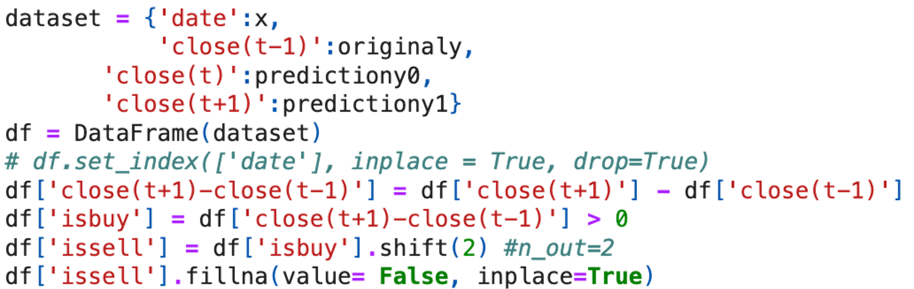
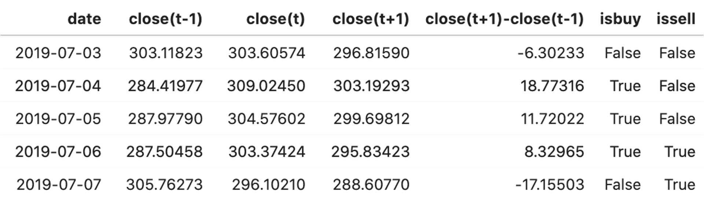
Strategy
Group 6 | Evaluating the Effectiveness of Machine Learning in Cryptocurrency Trading | LIANG Haojin
Two-days cycle
close(t-1): current price
close(t): predicted current price
close(t+1): predicted tomorrow price
Signal generation
close(t-1)<close(t+1) → buy signal
close(t-1)>close(t+1) → sell signal
Strategy objective
Minimize maximum drawdowns
Conservative with lower return
Introduction | Data Processing | Model Comparison | Model Training | Strategy & Backtesting | Results | Summary
Notes:
Our strategy operates on a two-day cycle and makes daily decisions based on the closing prices of the asset. close(t-1) is yesterday’s close price, which is equal to current stock price, close(t) is the predicted current price and close(t+1) is predicted tomorrow’s price. The logic behind the strategy is that if the closing price two days ahead is higher than the current price, a buy signal is triggered, and a unit of the asset is purchased. Then, two days after a buy signal is issued, a sell signal is triggered, mandating the sale of the purchased unit, regardless of the interim price action. This strategy is designed to minimize maximum drawdowns while acknowledging that it may yield relatively lower returns due to its conservative nature.
We calculated the difference in closing prices between ‘t+1’ and ‘t-1’, and based on this difference, columns of ‘isbuy’ and ‘issell’ are created. The ‘isbuy’ is True when the price difference is positive. The ‘issell’ column is generated by shifting the ‘isbuy’ signal by two periods, which means that a sell is scheduled two days after a buy signal. Fill the empty value as False, the result is shown in the left bottom.

Slide 24
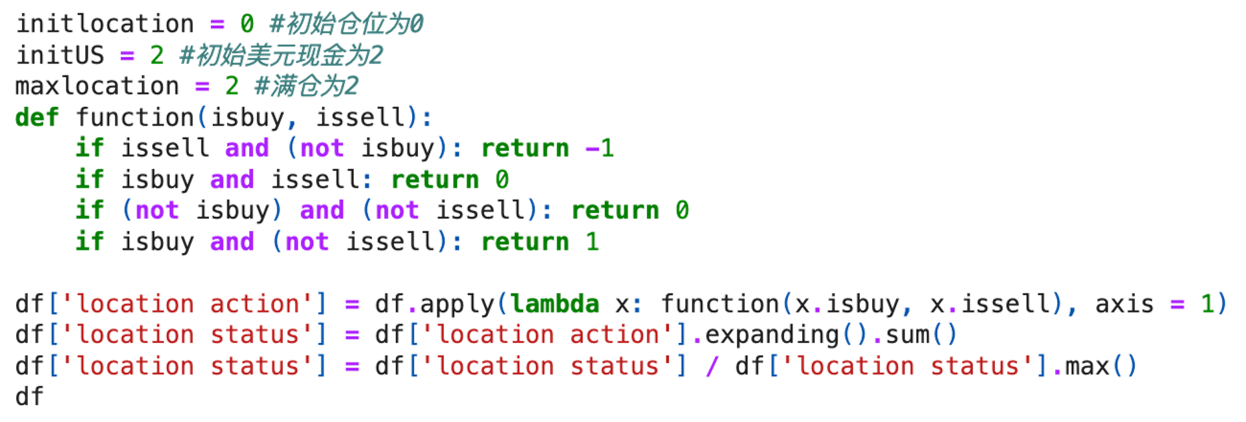
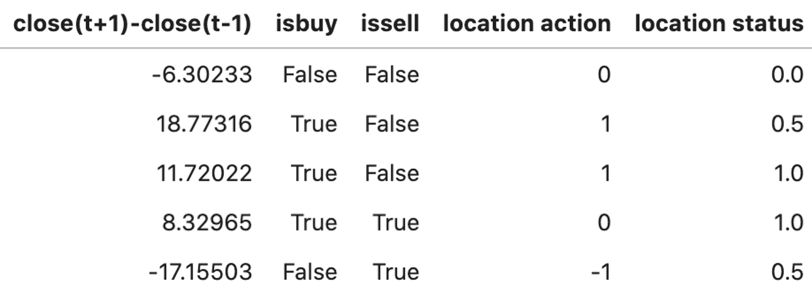
Strategy
Group 6 | Evaluating the Effectiveness of Machine Learning in Cryptocurrency Trading | LIANG Haojin
Position calculation
position | Isbuy=True | Isbuy=False
Issell=True | 0 | -1
issell=False | 1 | 0
(Max position=2)
Location action: cumulative position
Location status: normalize above
Introduction | Data Processing | Model Comparison | Model Training | Strategy & Backtesting | Results | Summary
Notes:
For translating trading signals into actionable position adjustments, we calculated the position.
Begin with initializing key parameters that define the starting capital and position constraints. Compositing the trading signals ‘isbuy’ and ‘issell’ to return a corresponding action: ‘-1’ for selling, ‘0’ for no action, ‘1’ for buying. The result is shown in the location action column.
Then, the cumulative position over time is calculated by summing the position actions sequentially. To facilitate the comparison and analysis of the position status, it is normalized by dividing it by its maximum value for providing a clear view of the current position in relation to the maximum position held during the trading period.

Slide 25
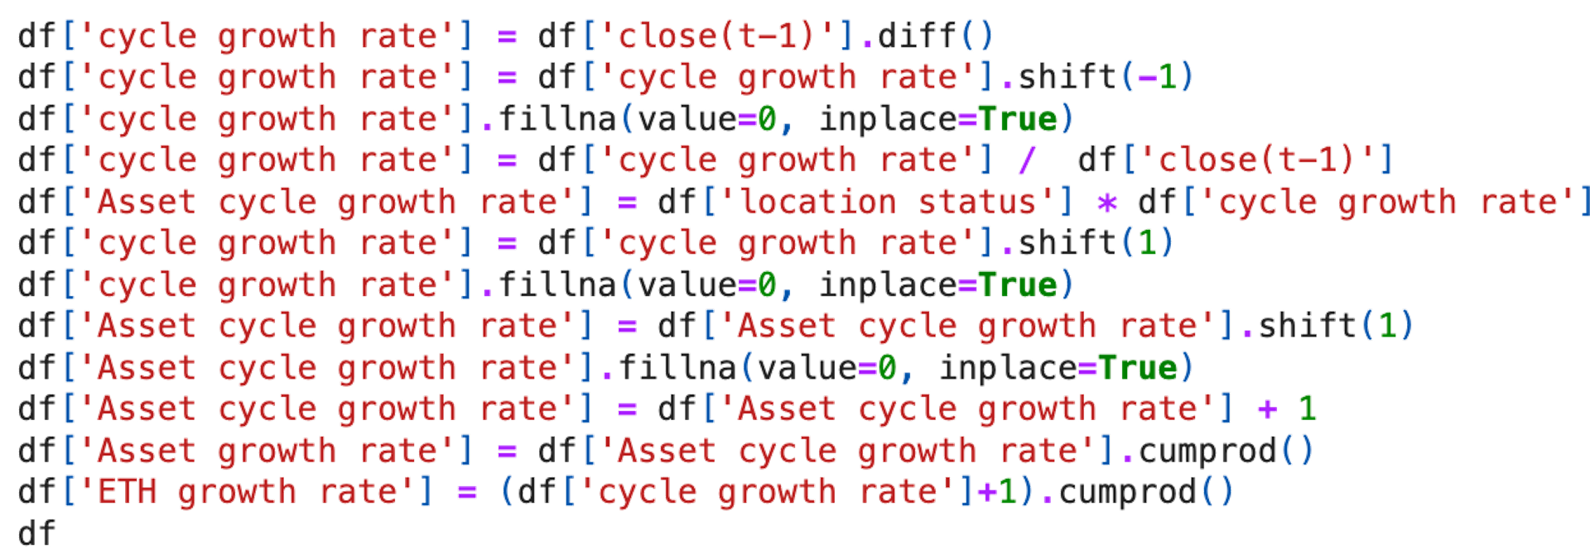
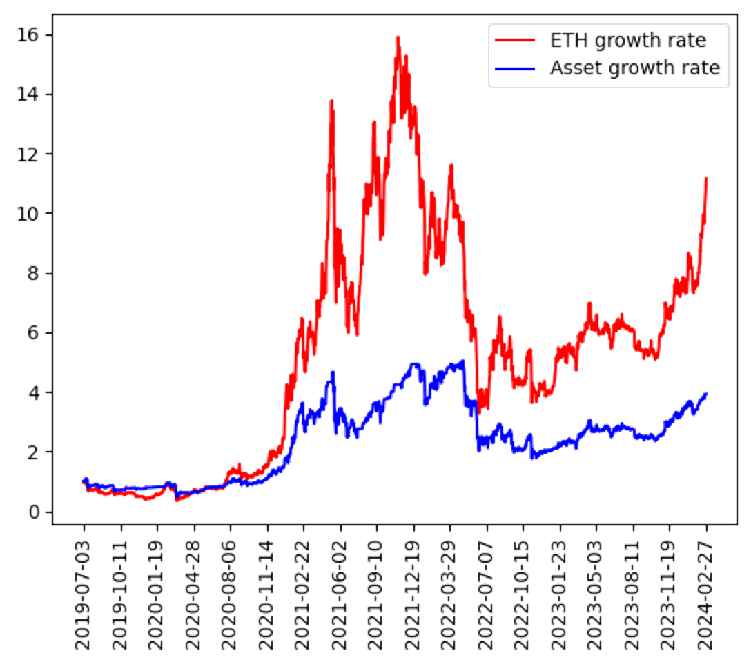
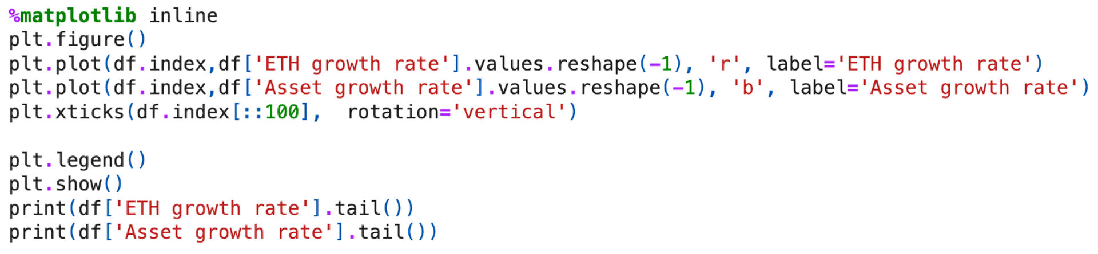
Back-testing
Group 6 | Evaluating the Effectiveness of Machine Learning in Cryptocurrency Trading | LIANG Haojin
Calculate performance curve
Cycle growth rate
Asset growth rate
ETH growth rate
Plot performance curve
ETH price vs strategy
position | Return
ETH | 11.155
Strategy | 3.93
Introduction | Data Processing | Model Comparison | Model Training | Strategy & Backtesting | Results | Summary
Notes:
After the strategy set up, we are gonna backtesting it.
We achieve this by first calculating the ‘cycle growth rate’, which is the percentage change in the asset’s price from one period to the next. Then, shifted by one period to align with the trading cycle, and filled empty cells with zeros to ensure data continuity. To factor in the dynamic position sizing, we then calculate the ‘Asset cycle growth rate’ by adjusting the ‘cycle growth rate’ based on the ‘location status’.
We add a baseline value of 1 to the ‘Asset cycle growth rate’ and calculate the cumulative ‘Asset growth rate’. Meanwhile, the ‘ETH growth rate’ is derived to illustrate the performance of a consistently held position over the same timeframe.
For visualizing the return and qualitatively assessing the strategy's effectiveness, we plotted in a time series chart. Both ETH growth rate and Asset growth rate are plotted. We can observe from the graph, the asset with trading strategy is more conservative while make decent return with 3.93 dollars if we invest for 1 dollar at the beginning of the period compare with 11.16 dollars in buying ETH straight away

Slide 26
06
Results
HUANG Shiqi
Notes:
In this part, I will discuss more about the detailed data results.

Slide 27
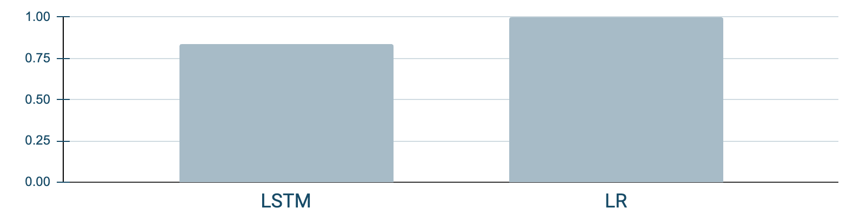
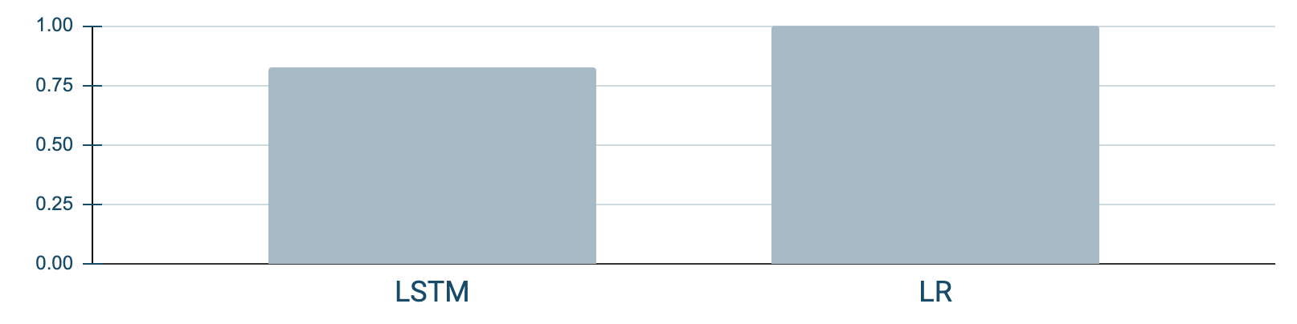
Results of Model Comparison
Group 6 | Evaluating the Effectiveness of Machine Learning in Cryptocurrency Trading | HUANG Shiqi
Mean Square Error
Root Mean Square Error
LSTM | 0.004739
LR | 155.519430
LSTM | 0.068838
LR | 12.470743
Explained Variance Ratio
R-squared
0.999867
0.999865
0.834800
0.824436
Introduction | Data Processing | Model Comparison | Model Training | Strategy & Backtesting | Results | Summary
Notes:
For the comparison of LSTM model and linear regression model, we calculated MSE, RMSE, explained variance ratio, r-squared of each model to evaluate the performance of models and then choose the optimal model to train. As you can see in the table, the MSE and RMSE of the LSTM model are extremely small compared to that of the linear regression model, which means that the performance of these two measures of LSTM is significantly outperformed by linear regression model. And the prediction error of the LSTM model is very small, and the prediction result is as close as possible to the actual value. Next, is about explained variance ratio and r-squared, both of which are smaller for the LSTM model than for the LR model. But the difference is very small, which means that the LSTM model also has a good interpretive power and provides a good fit to the price. Since MSE and RMSE outperform the LR model by so much that the small difference of the explained variance ratio and the r-square can be disregarded. Thus, we choose the LSTM model for subsequent price prediction.

Slide 28
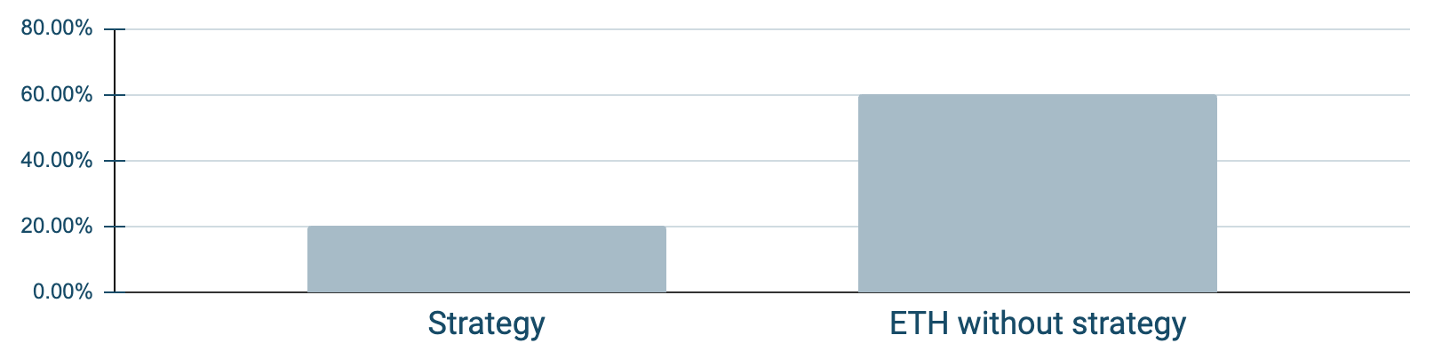
Performance Analysis of Strategy
Group 6 | Evaluating the Effectiveness of Machine Learning in Cryptocurrency Trading | HUANG Shiqi
Annual Volatility
Measures
Strategy
Without Strategy
60.01%
Holding Period Return
293%
1015.47%
Annual Return
2.73%
9.48%
20.09%
Sharpe Ratio
1.89
1.38
After Strategy
Maximum Drawdown
0.65
0.66
Maximum Drawdown
Volatility
Calmar Ratio
4.19
14.30
Stability
Introduction | Data Processing | Model Comparison | Model Training | Strategy & Backtesting | Results | Summary
Notes:
After buying and selling though previous mentioned strategy, we use some measures to see the performance. As the diagram shows, the annual volatility has been significantly reduced, meaning that investors are less exposed to volatility risk after using the strategy. Due to the good performance of ETH price during the back testing period, the return is very high, and then the annual return and calmar ratio are also high accordingly. However, the maximum drawdown reduces and the sharpe ratio turn to be higher, the investor can earn more with the same risk of volatility. This strategy minimize the drawdown, and reduce the volatility to reach a more stable earning, it is very suitable for today’s unstable financial market.

Slide 29
07
Summary
CHEN Yunfan

Slide 30
Recap of key findings and insights
Group 6 | Evaluating the Effectiveness of Machine Learning in Cryptocurrency Trading | CHEN Yunfan
Superior Performance of LSTM
The LSTM model outperformed the Linear Regression (LR) model in terms of predictive accuracy, as evidenced by significantly lower Mean Square Error (MSE) and Root Mean Square Error (RMSE).
Profitability of ML-Based Trading Strategies
The backtesting of the ML model demonstrated its potential in generating profitable trading strategies. The analysis revealed a substantial holding period return of 293.00% and an annual return of 4.86%.
Introduction | Data Processing | Model Comparison | Model Training | Strategy & Backtesting | Results | Summary

Slide 31
Further Considerations
Group 6 | Evaluating the Effectiveness of Machine Learning in Cryptocurrency Trading | CHEN Yunfan
Multi-Factor Analysis
Incorporating market sentiment, social media trends, trading indicators, and macroeconomic variables enhances predictive power.
Hyperparameter Optimization
Fine-tuning parameters like LSTM layers, hidden units, learning rate, and dropout rate is crucial for model performance.
Trading Cost
Accounting for transaction fees, slippage, and other costs provides a realistic assessment of strategy performance in real-world trading scenarios.
However, it is important to note that despite the inclusion of additional factors and careful hyperparameter tuning, the predictive accuracy of LSTM models for cryptocurrency returns still exhibits inherent stochasticity.
Introduction | Data Processing | Model Comparison | Model Training | Strategy & Backtesting | Results | Summary
Notes:
加一个要考虑trading cost

Slide 32

Thanks!
Group 6
FTEC 5530
Evaluating the Effectiveness of Machine Learning in Cryptocurrency Trading

